Slide 1

WAY TO ENTERPRISE
AWS
VTI ACADEMY
Author: duy.nguyenngoc1@vti.com.vn

Slide 2
Agenda
IAM Service
Organizations Service
Assignments
Quiz
Copyright © VTI Academy All Rights Reserved

Slide 3
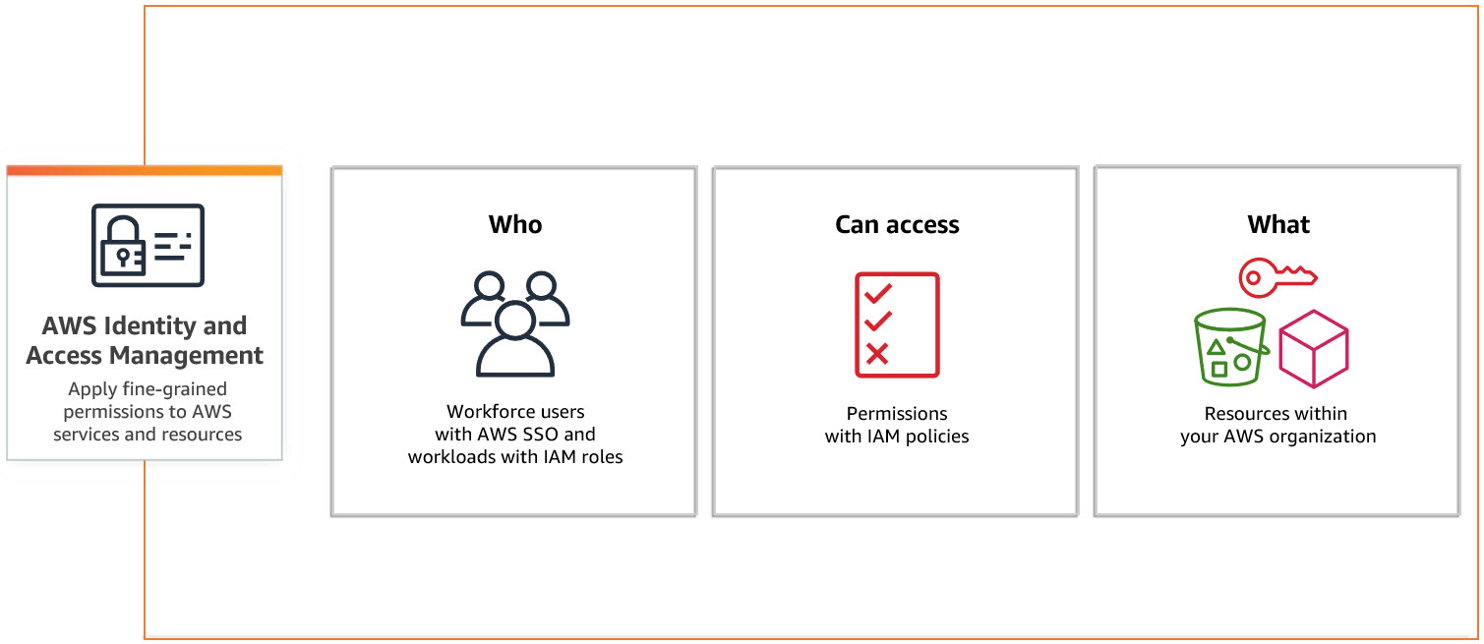
IAM Service
Stands for Identity and Access Management
Is a service to help control access to AWS resources
All billing of IAM User will be charged to root account
Global service
Price: free

Slide 4
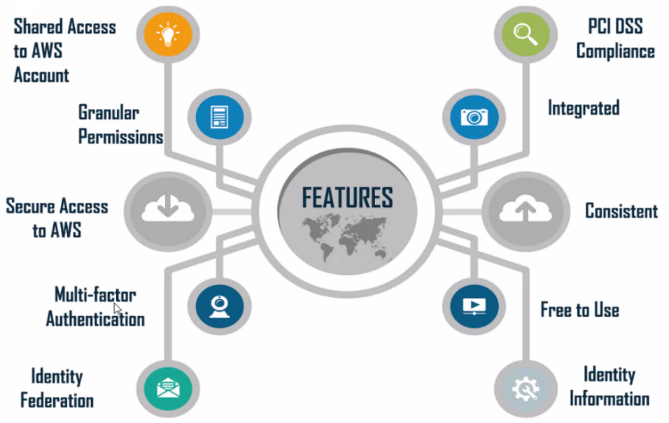
IAM Service
Feature

Slide 5
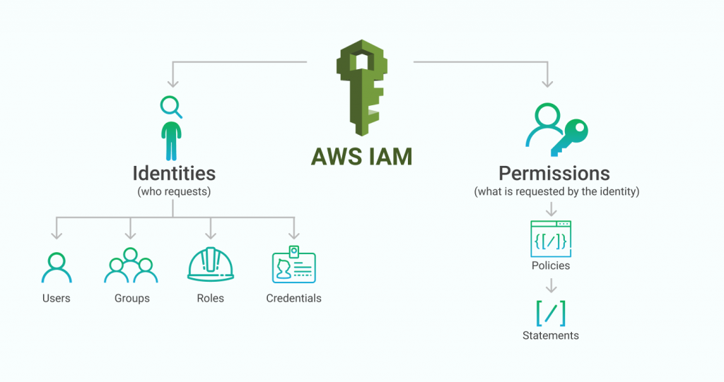
IAM Service
Components
Identities
Permissions

Slide 6
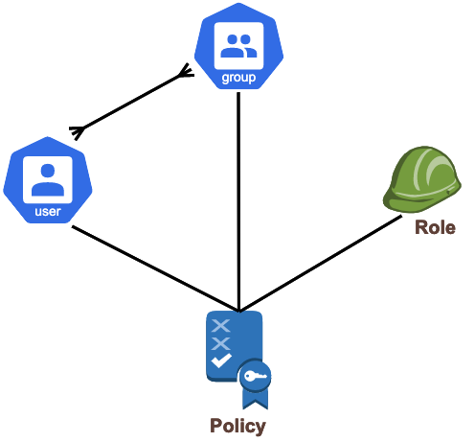
IAM Service
Identities
Users: Root User, IAM User, Federating existing user
IAM Group
IAM Role / Temporary security credentials
AWS Resource (S3, EC2, application, …)

Slide 7
IAM Service
Root User
Login with email & password for Web UI
Access key for programming (access key ID + a secret access key)
Full Permissions
Best Practices
Do not log in frequently, log in only when you need to authorize the User, view & pay billing
Should create MFA and remove access key (avoid hacker scan)
Should create 1 IAM Group & IAM User and assign admin rights (replacement for Root user)
Set Password policy for IAM User

Slide 8
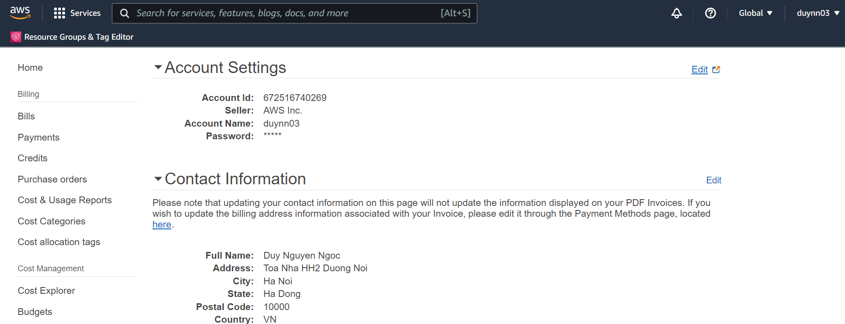
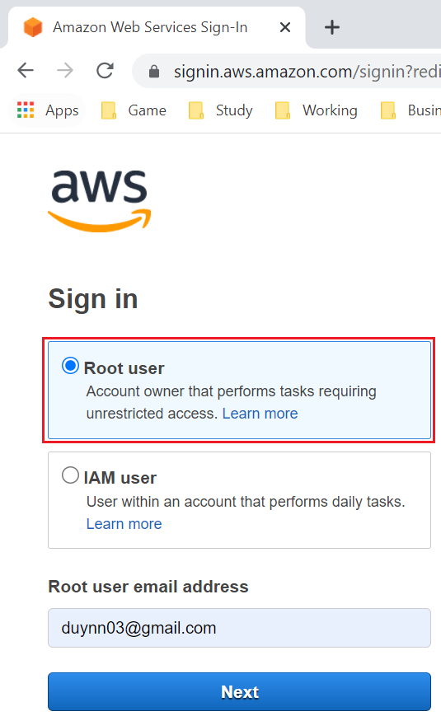
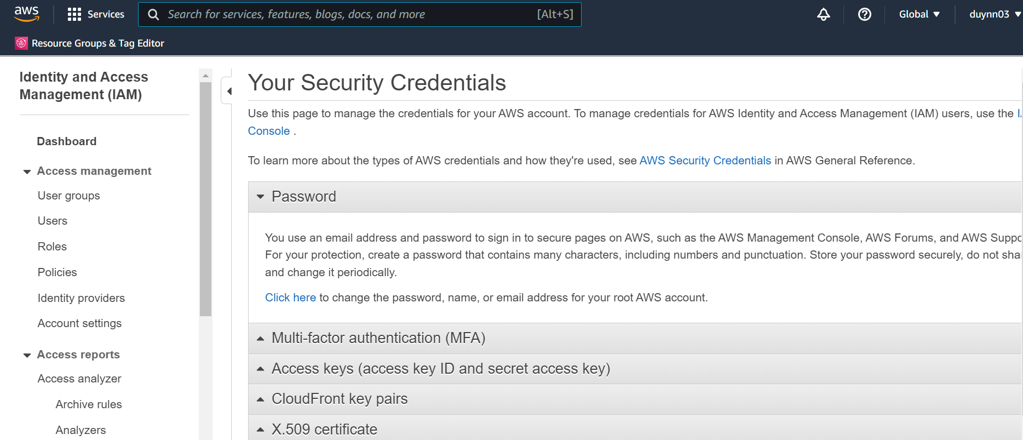
IAM Service
Basic Information
Sign in Root User in Console page
Security

Slide 9
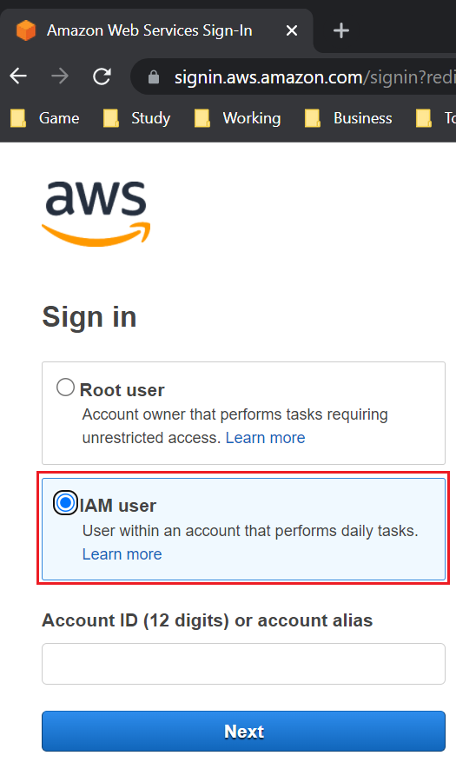
IAM Service
IAM User
Login with username & password for Web UI
Access key for programming
Limit permissions
There can be many IAM users in a Root user
Each IAM user will be independent of each other in a Root user
Best Practices
Each IAM user can represent a person, application, service...
Long-term
Sign in IAM User in Console page

Slide 10
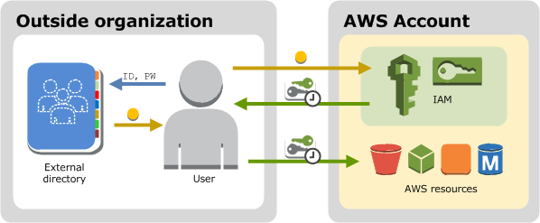
IAM Service
Federating existing user
Login via Single Sign-On (SSO) 🡺 don’t create IAM User
Usecases
Login with Amazon, Facebook, Google, any OpenID Connect (OIDC), ...
Login with company’s account

Slide 11
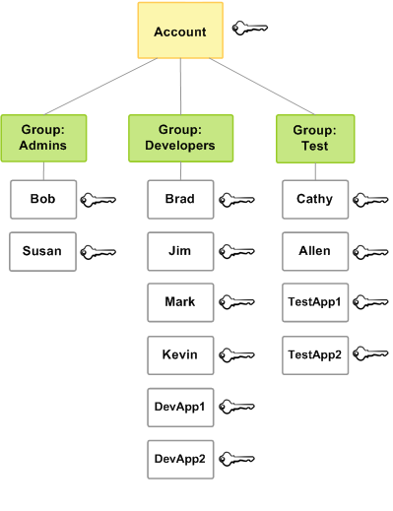
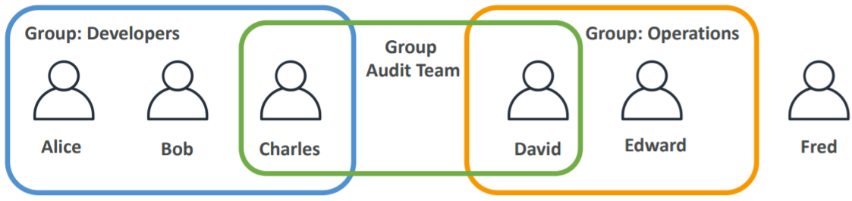
IAM Service
IAM Group
There can be many IAM Groups in 1 Root user
A user can belong to many groups
Best Practices
Each user in the group usually has the same policy
Ex: project, department, position, ...
A user can belong to many groups

Slide 12
IAM Service
Demo
Create User & Group
Sign in Root User & IAM User in Console
Password Policy
Add MFA
Access user via Console, CLI, SDK
https://docs.aws.amazon.com/IAM/latest/UserGuide/getting-started.html

Slide 13
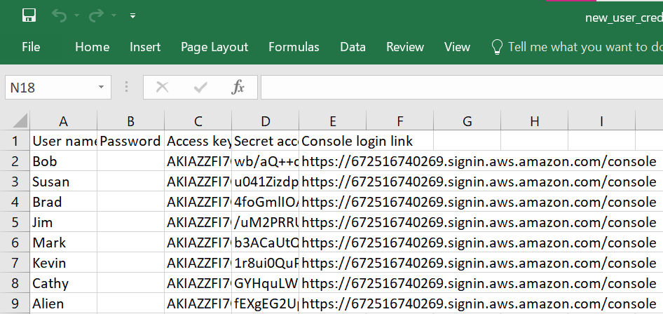
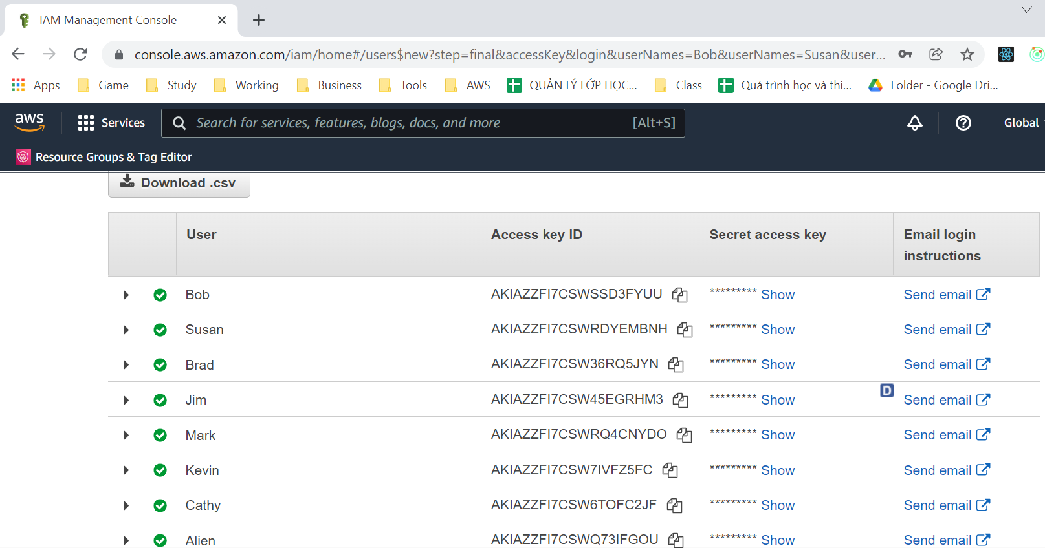
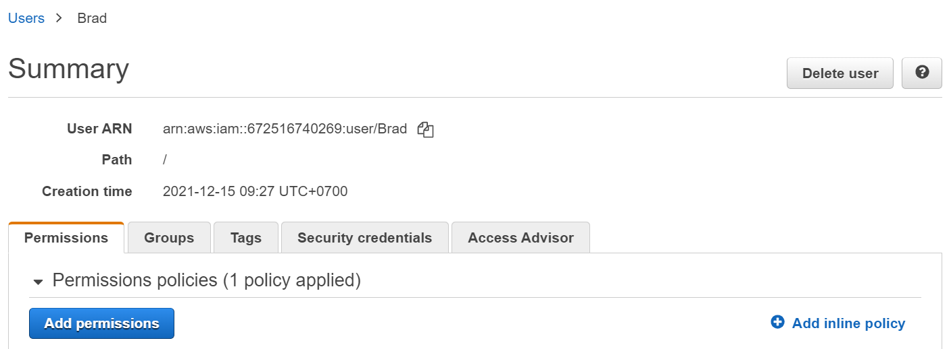
IAM Service
Create User & Group
Create User
Tutorial: https://docs.aws.amazon.com/IAM/latest/UserGuide/getting-started_create-admin-group.html

Slide 14
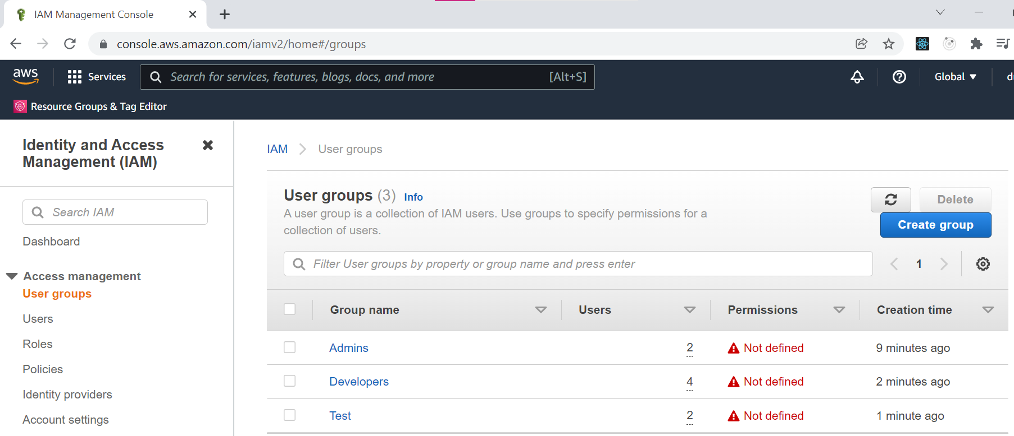
IAM Service
Create Group

Slide 15
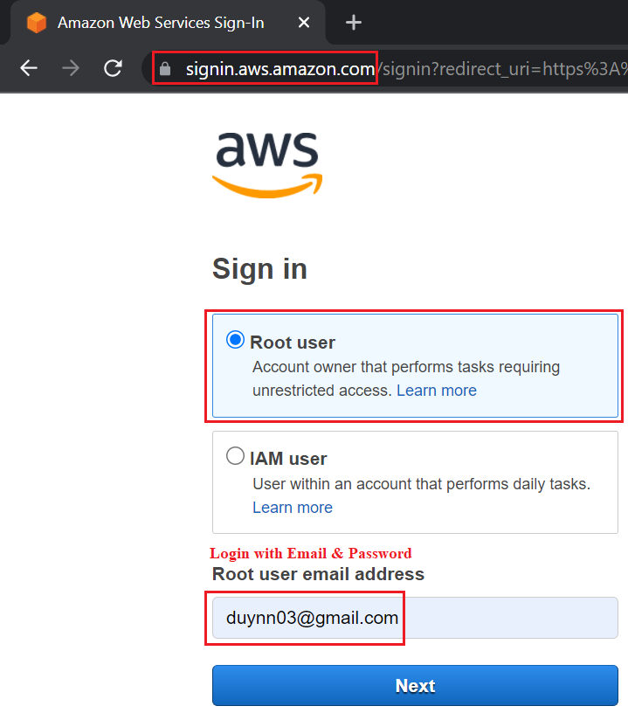
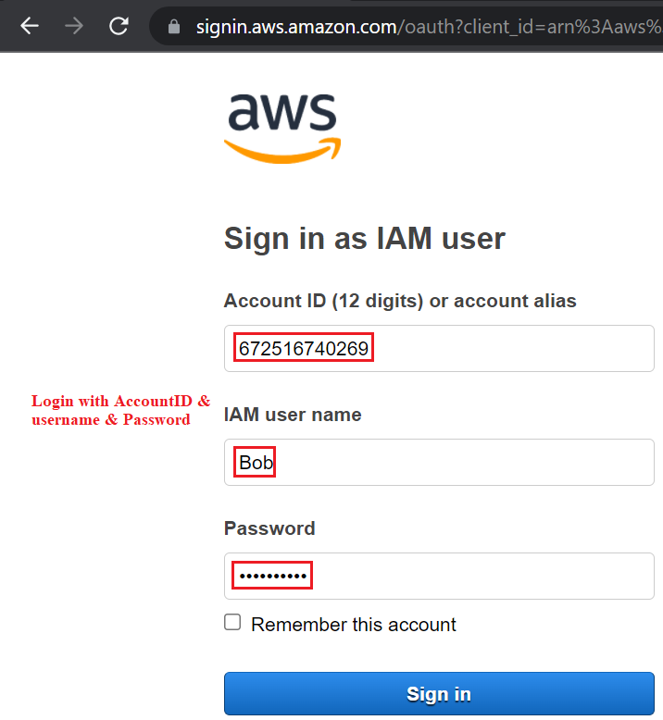
IAM Service
Sign in Root User & IAM User
Root User
IAM User
Tutorial: https://docs.aws.amazon.com/IAM/latest/UserGuide/id_users_sign-in.html

Slide 16
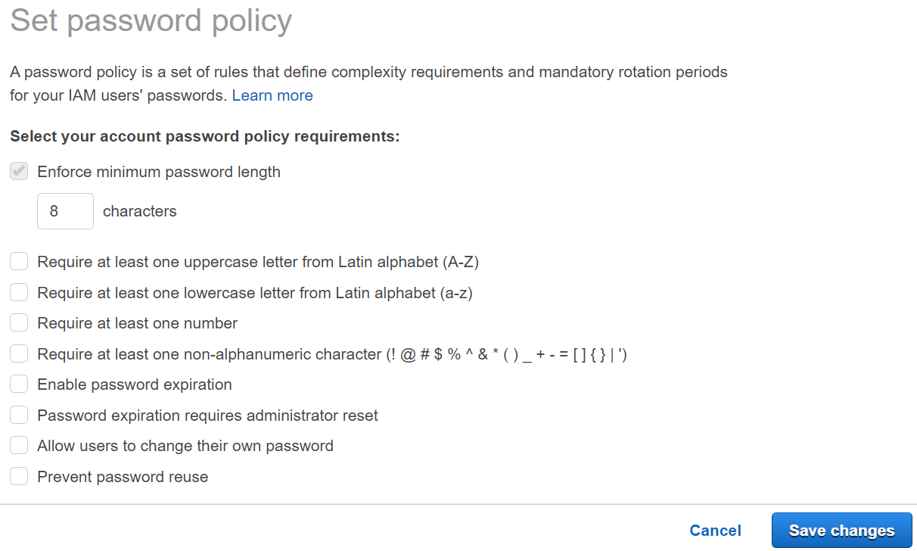
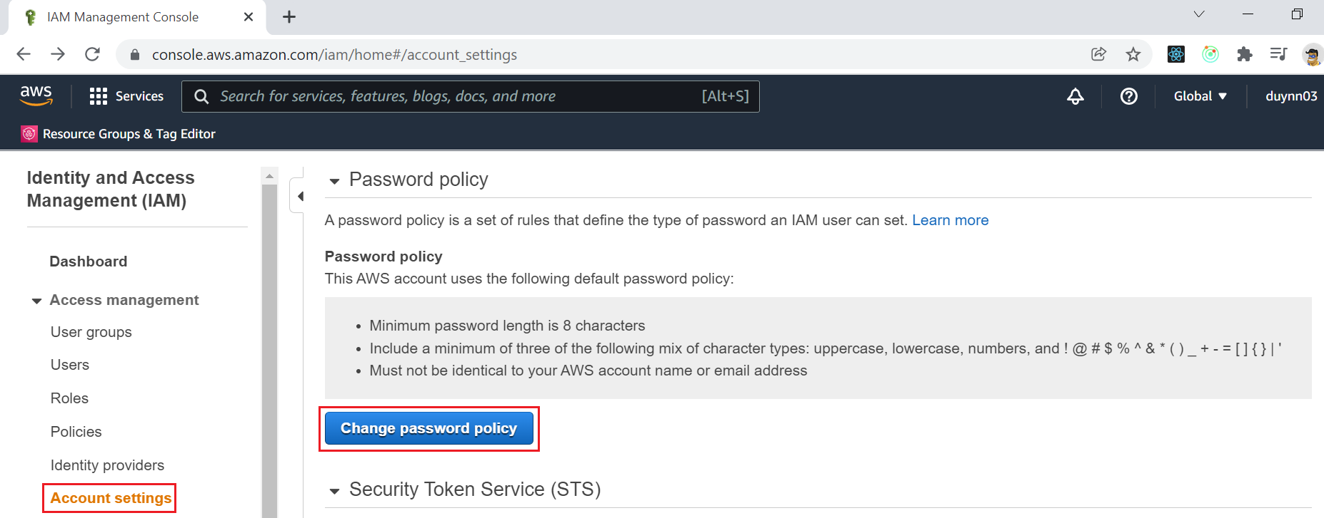
IAM Service
Password policy

Slide 17
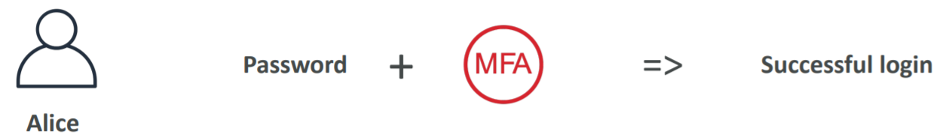
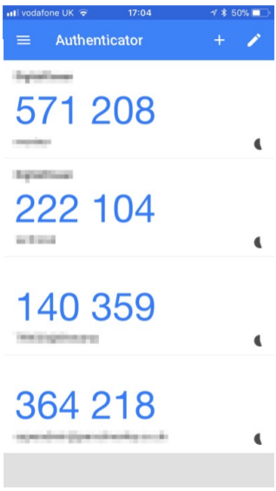
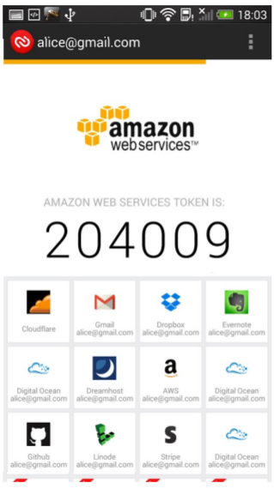

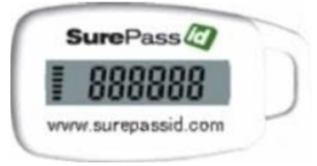
IAM Service
Add MFA
Virtual MFA Device
Hardware Key Fob MFA Device
Google Authenticator
(Phone Only)
Authy
(Multi-device)
Gemalto (3rd party)
SurePassID (3rd party)
https://aws.amazon.com/iam/features/mfa/?audit=2019q1

Slide 18
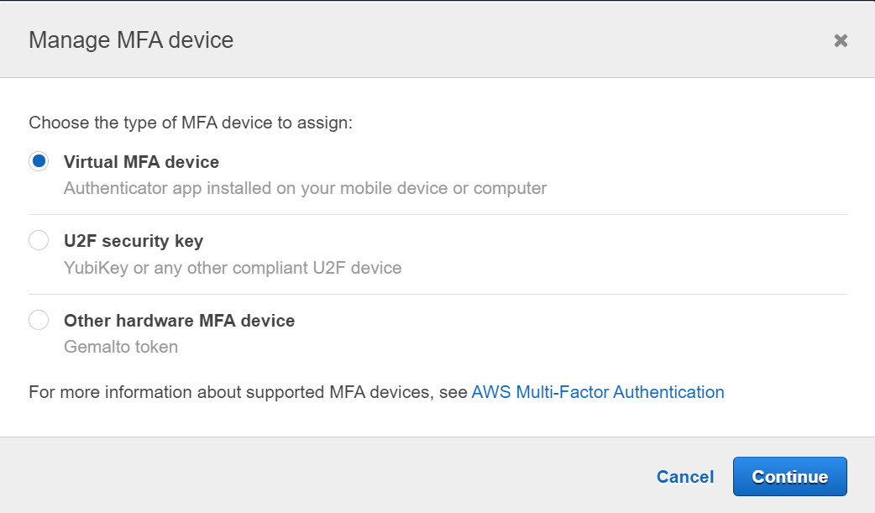
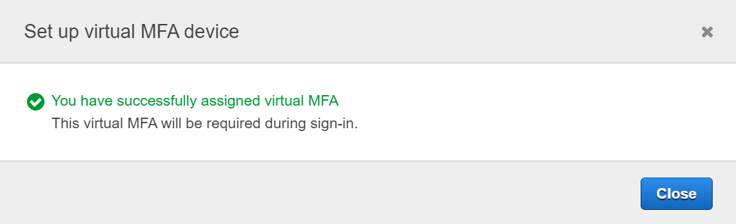
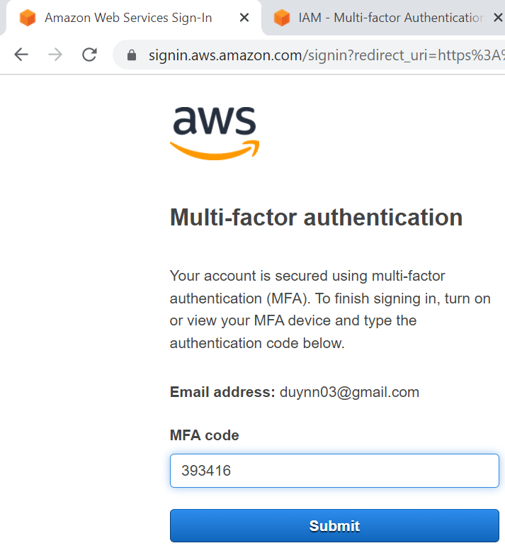
IAM Service
Google Authenticator
Tutorial for Root user: https://docs.aws.amazon.com/IAM/latest/UserGuide/id_credentials_mfa_enable_virtual.html#enable-virt-mfa-for-root
Tutorial for IAM User: https://www.youtube.com/watch?v=miS7GdKJrZQ

Slide 19
IAM Service
Access user via Console, CLI, SDK
Console: protected by password + MFA
Command Line Interface (CLI): protected by access keys
A tool that enables you to interact with AWS services using commands in your command-line shell
Direct access to the public APIs of AWS services
Software Developer Kit (SDK): for code, protected by access keys
Enables you to access and manage AWS services programmatically, embedded within your application
Web: JavaScript, Python, PHP, .NET, Java, Go, Node.js, C++, Mobile: Android, iOS, …, IoT Device: Embedded C, Arduino, …

Slide 20
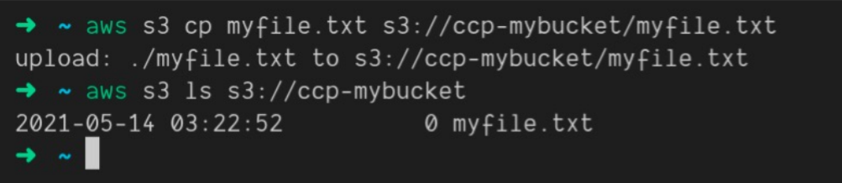
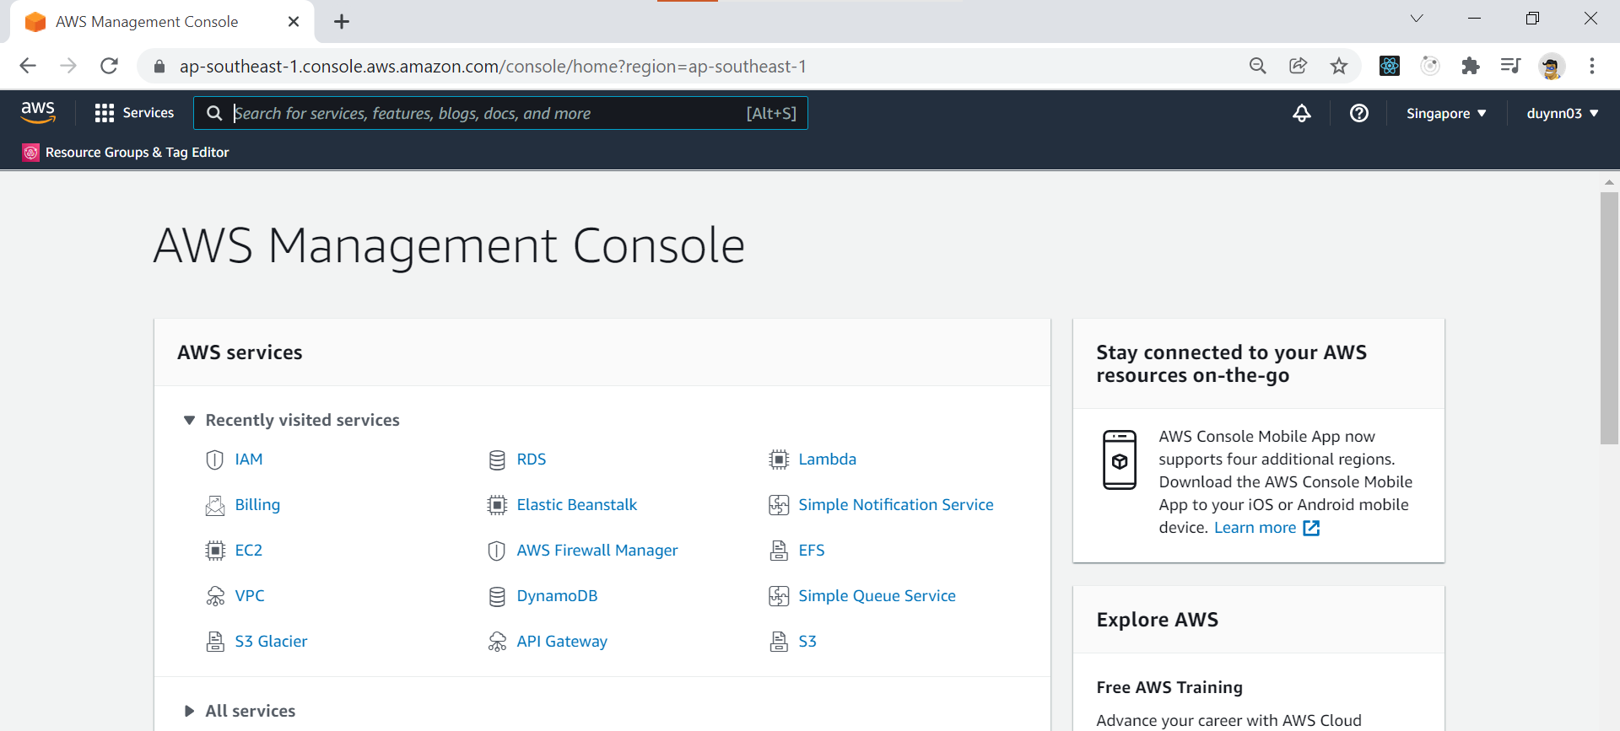
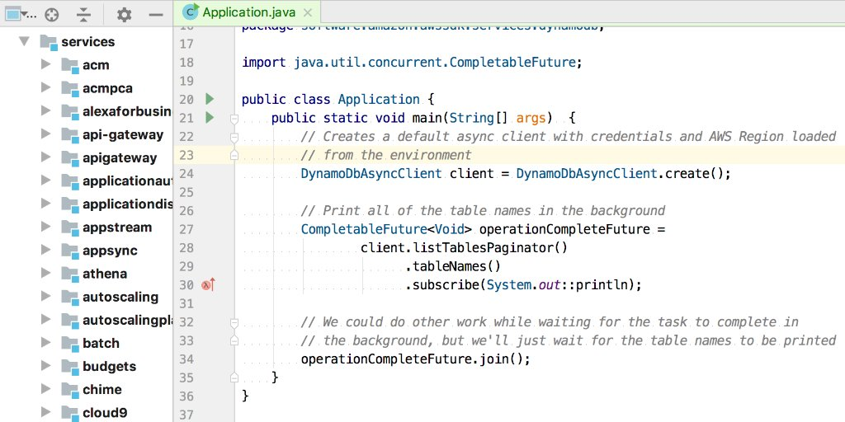
IAM Service
CLI
Console
SDK

Slide 21
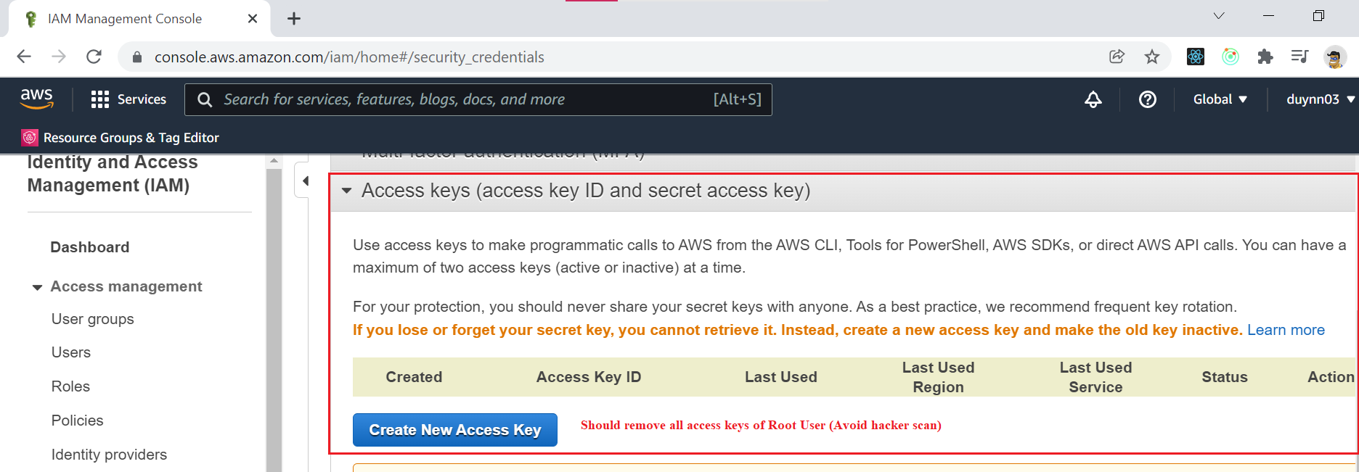
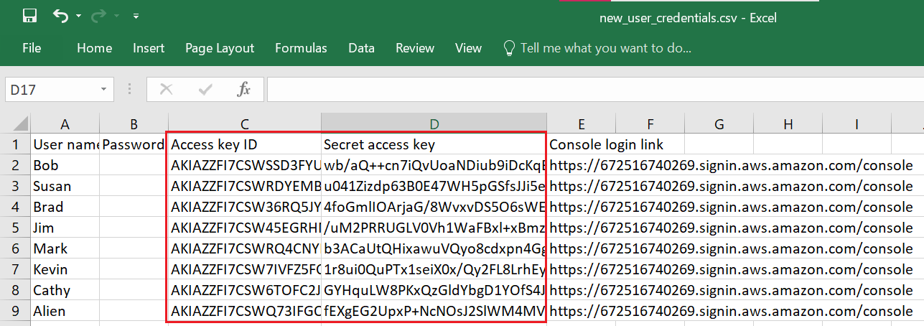
IAM Service
Get Access Key
Rotate all your keys often
Never share IAM users & Access Keys
Root User
Access key ID ~ Username
Secret access key ~ Password
IAM User

Slide 22
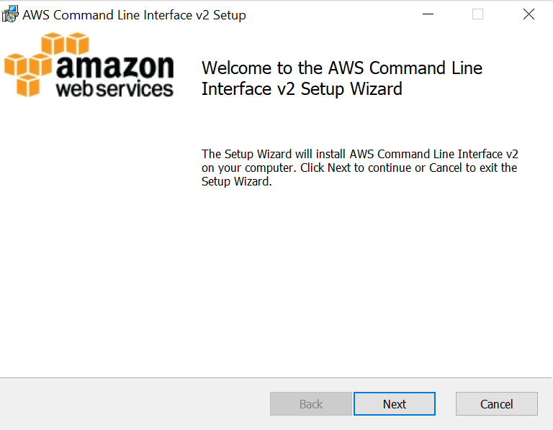
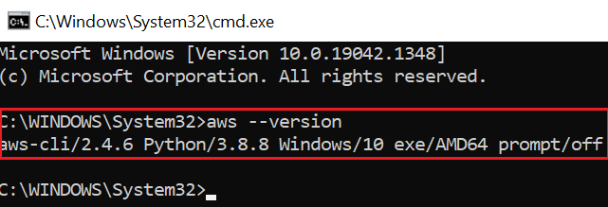
IAM Service
CLI
https://docs.aws.amazon.com/cli/latest/userguide/getting-started-install.html

Slide 23
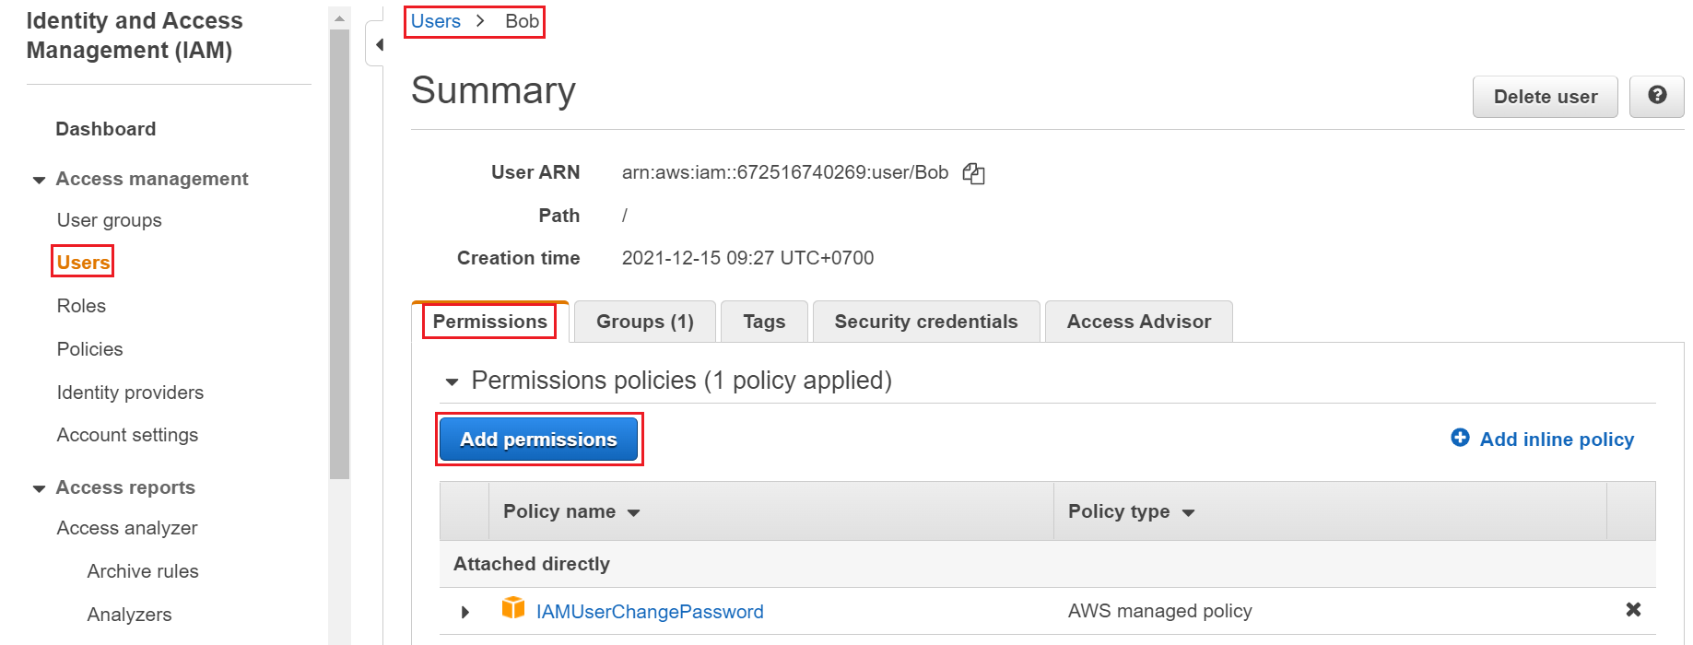
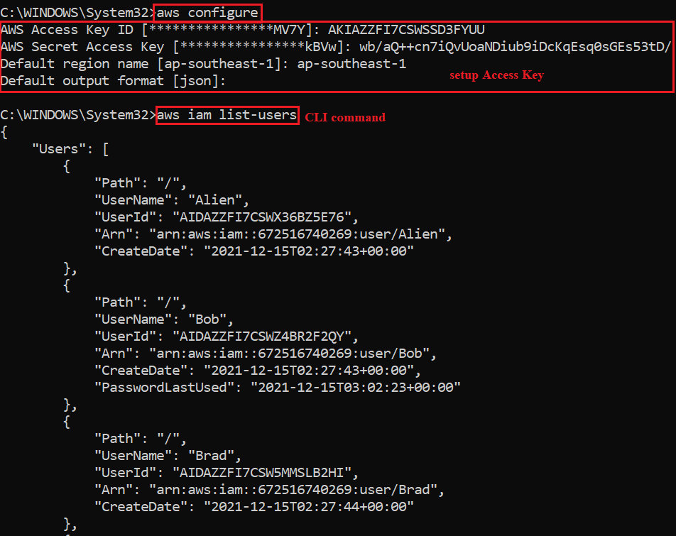
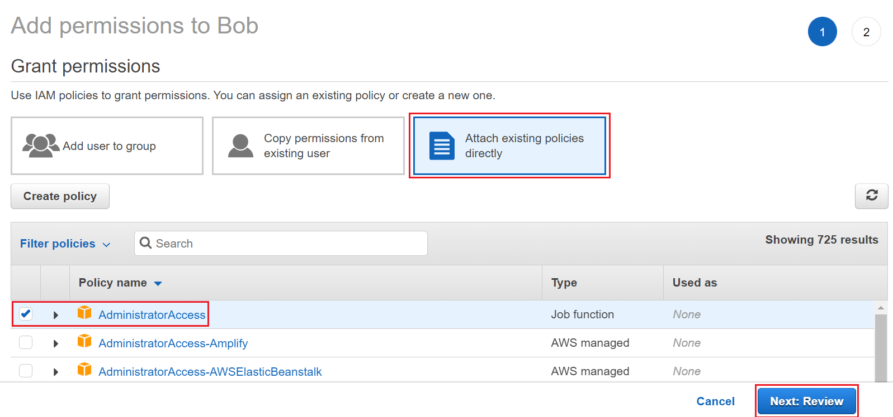
IAM Service
Setup & Execute CLI Command
Grant Administrator Permissions for User
aws service_name help

Slide 24
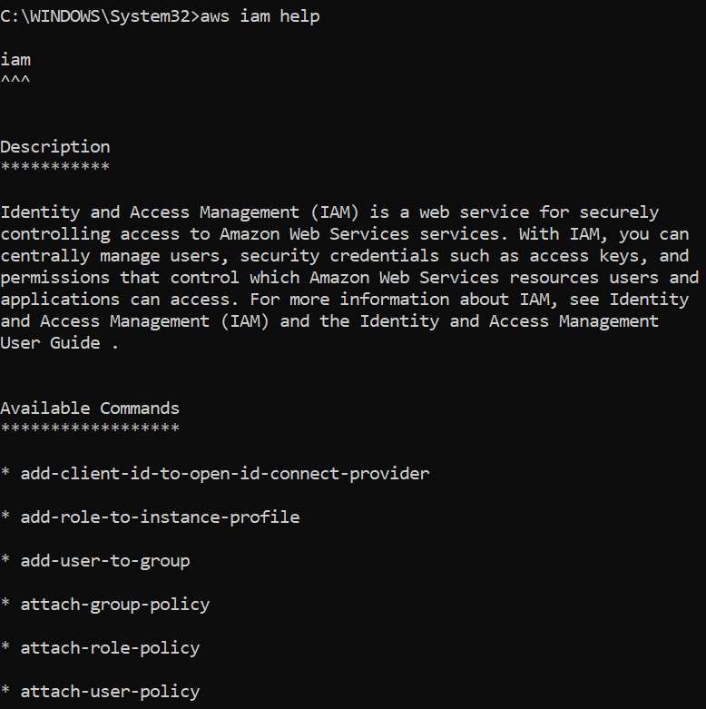
IAM Service
aws service_name help
https://docs.aws.amazon.com/cli/index.html

Slide 25
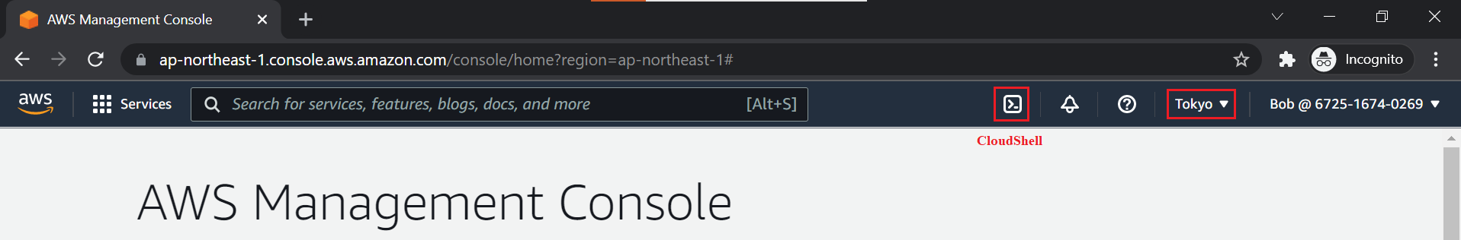
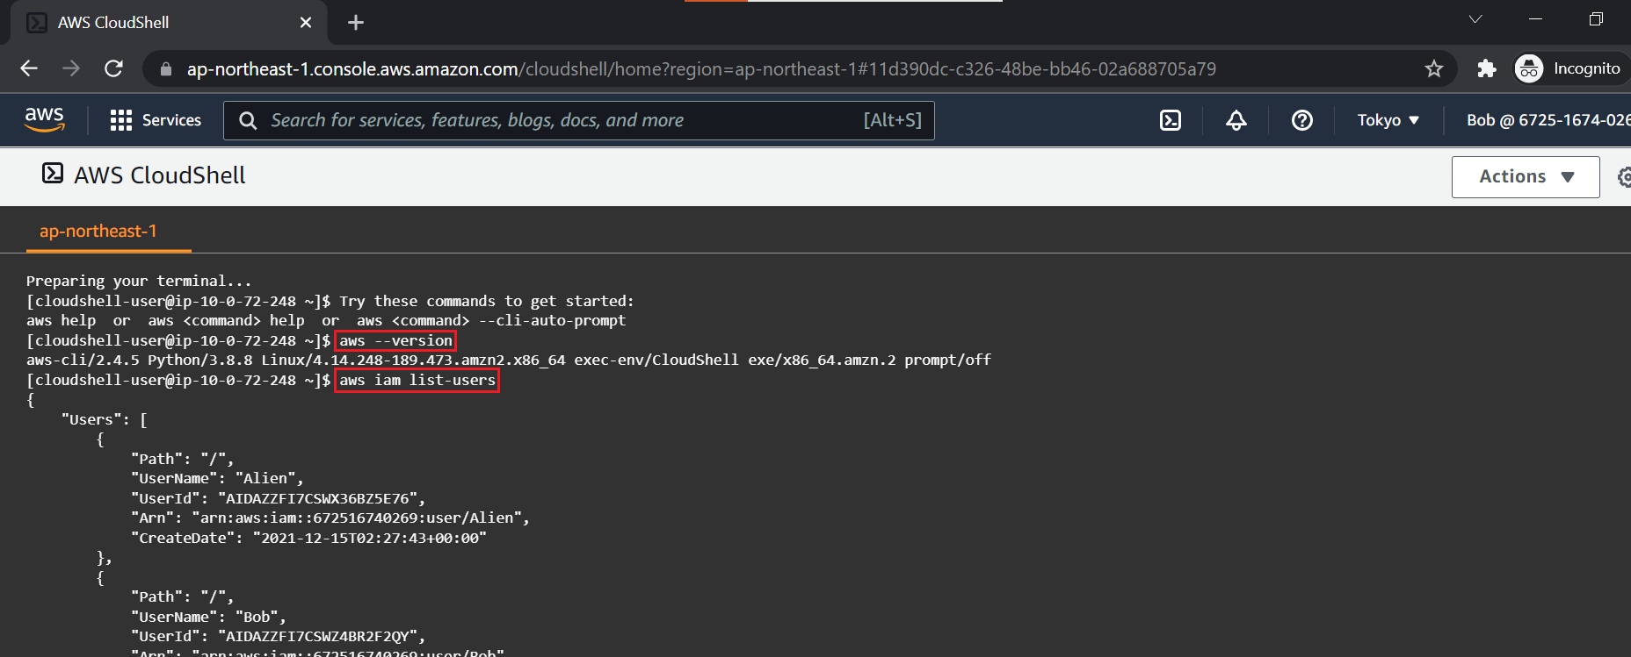
IAM Service
CloudShell
CloudShell available in Regions: https://docs.aws.amazon.com/general/latest/gr/cloudshell.html
https://docs.aws.amazon.com/cli/latest/userguide/getting-started-install.html

Slide 26
Assignment
Self-practice

Slide 27
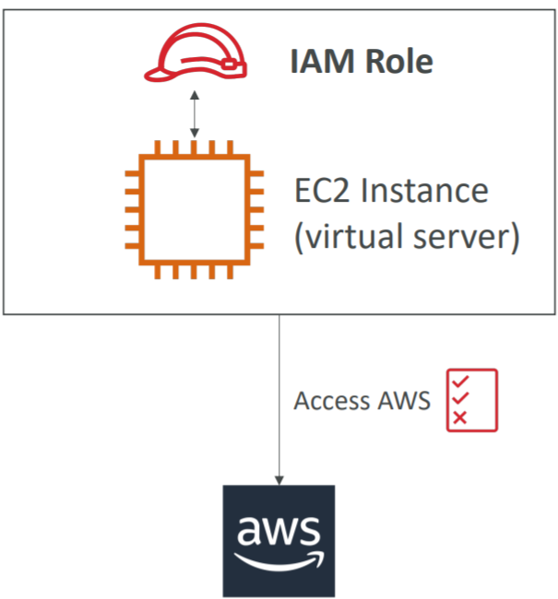
IAM Service
IAM Role
No username & password, access key
Is a set of policies
Can be reuse
Usecases
Grant permission for
AWS Service
Other Account (Not for IAM User, IAM Group), 3rd party
Federating existing users, Web Identity
Some AWS service will need to perform actions on your behalf

Slide 28
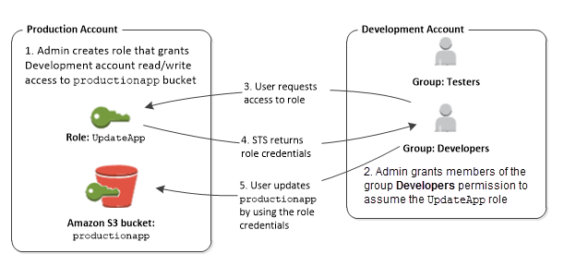
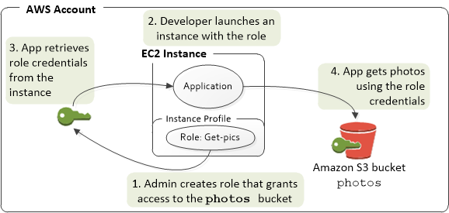
IAM Service
Allows AWS services (EC2, Lambda, ...) to execute actions on behalf of the root user
Allow other accounts or 3rd party to access resources
More secure than entering the access key for ec2

Slide 29
IAM Service
Temporary security credentials
It is a temporary credentials, which automatically expires after a period of time
Similar to Role but cannot reuse
Usecases
Short-term
Use in conjunction with Federating existing user for single sign-on login

Slide 30
IAM Service
Demo (NEXT LESSON)
Create policy
Create Role & attach policy to IAM Role
Assume IAM Role to AWS Service
Test

Slide 31
IAM Service
Policies
Contains permissions that define the identity will take what action with the condition
JSON
Attach to multiple Identities & AWS resources
Can merge multiple policies together
Deny has priority higher than Allow

Slide 32
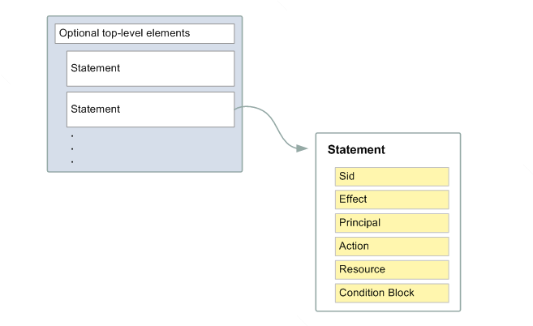
IAM Service
Structure
Version: version of policy
Sid: statement ID
Effect: allow/deny
Principal: identity
Action/NotAction
Resource: AWS resources
Condition: condition for AWS resources

Slide 33
IAM Service
Demo Identity-based policy
Create policy
Attach policy to IAM User
Test

Slide 34
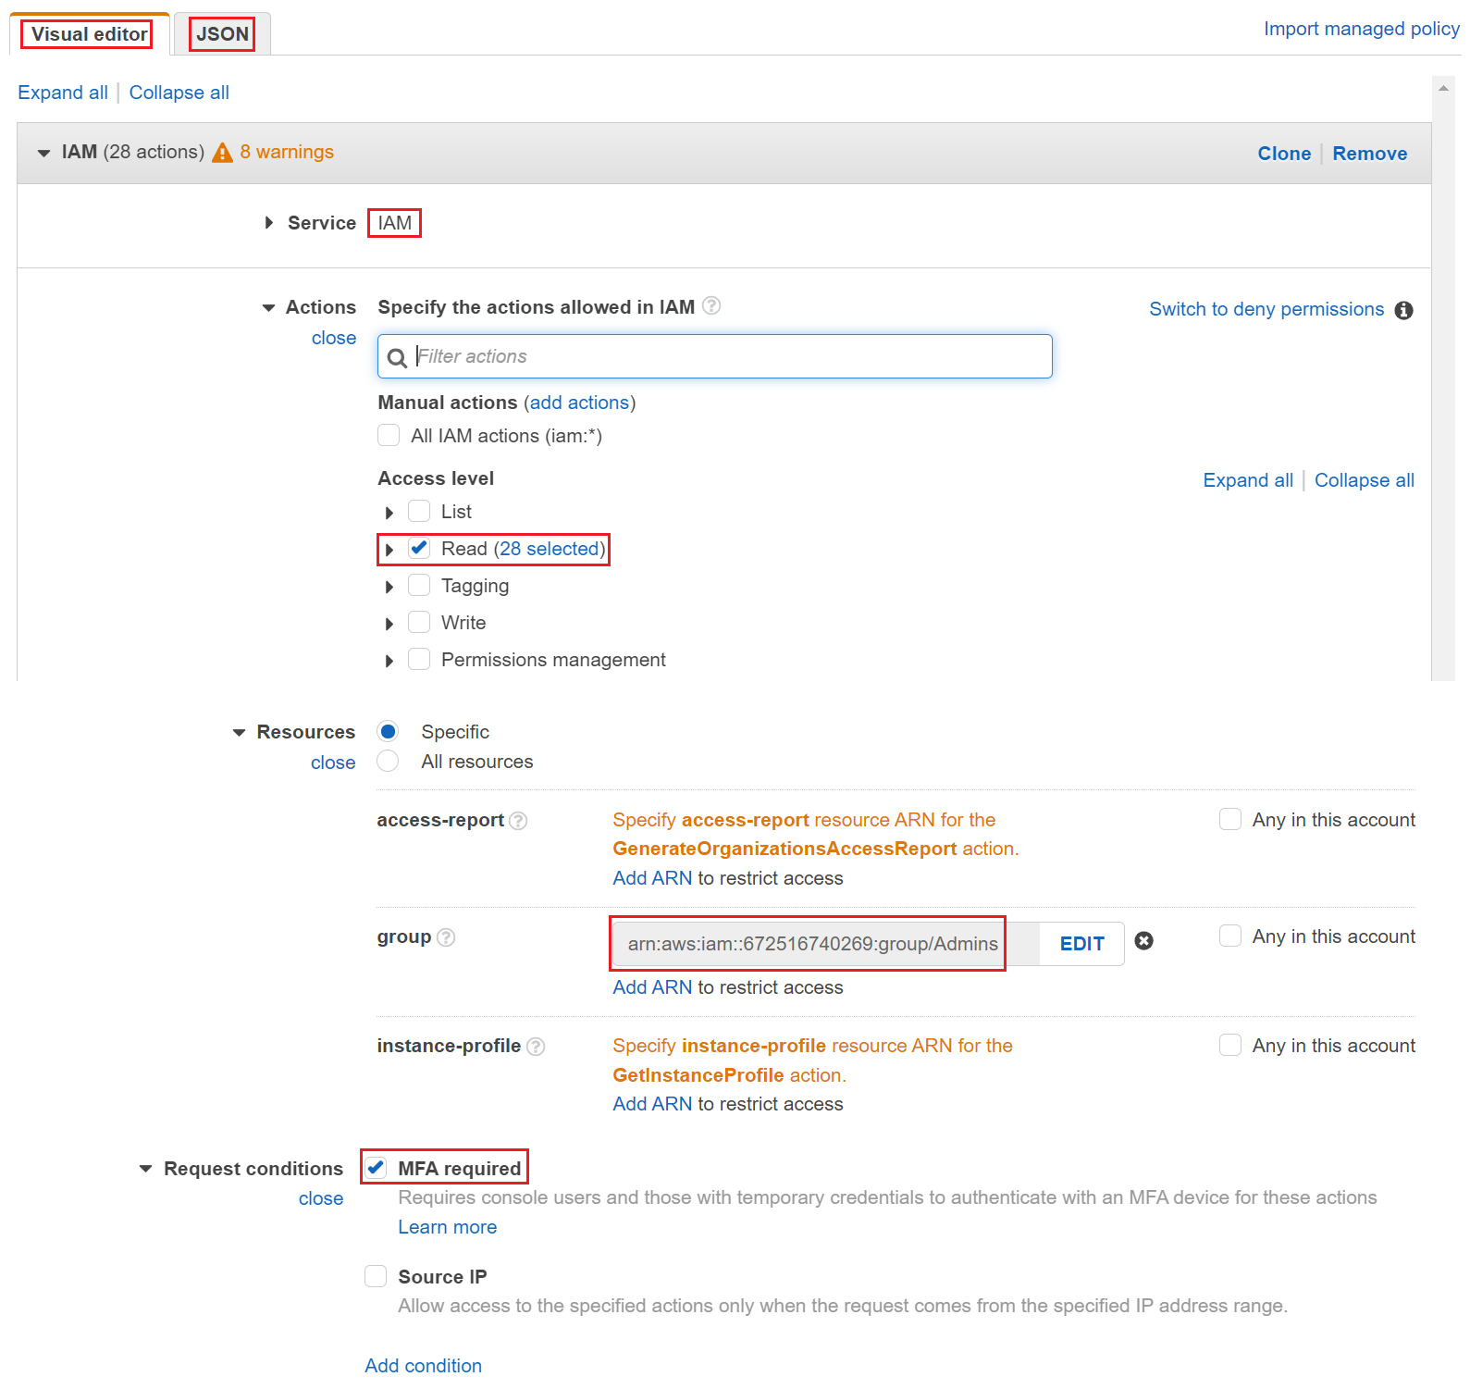
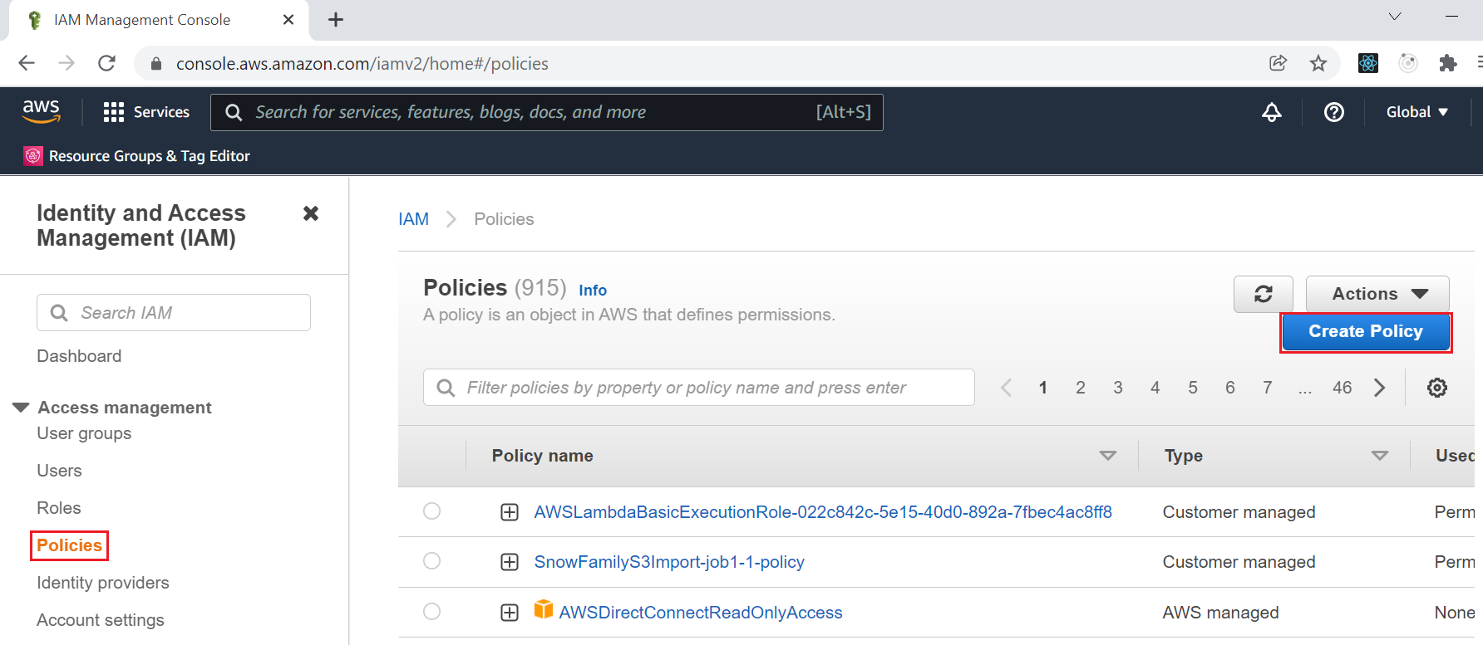
IAM Service
Create policy
Visual Editor

Slide 35
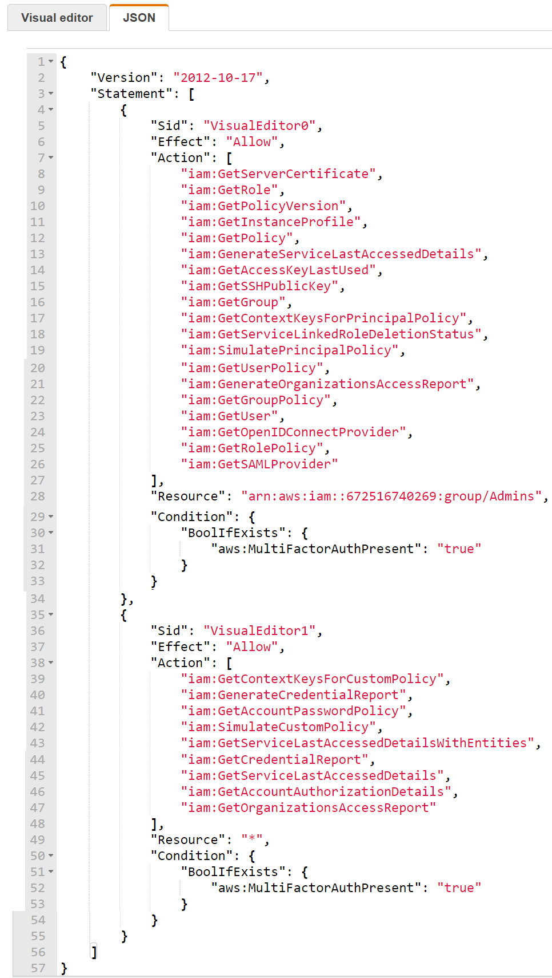
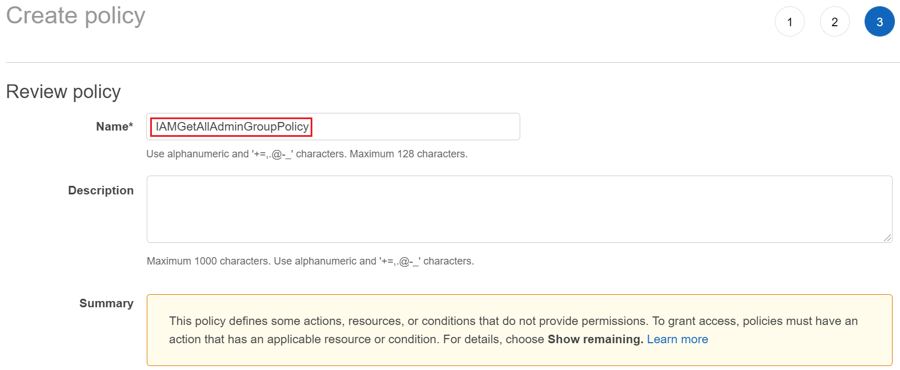
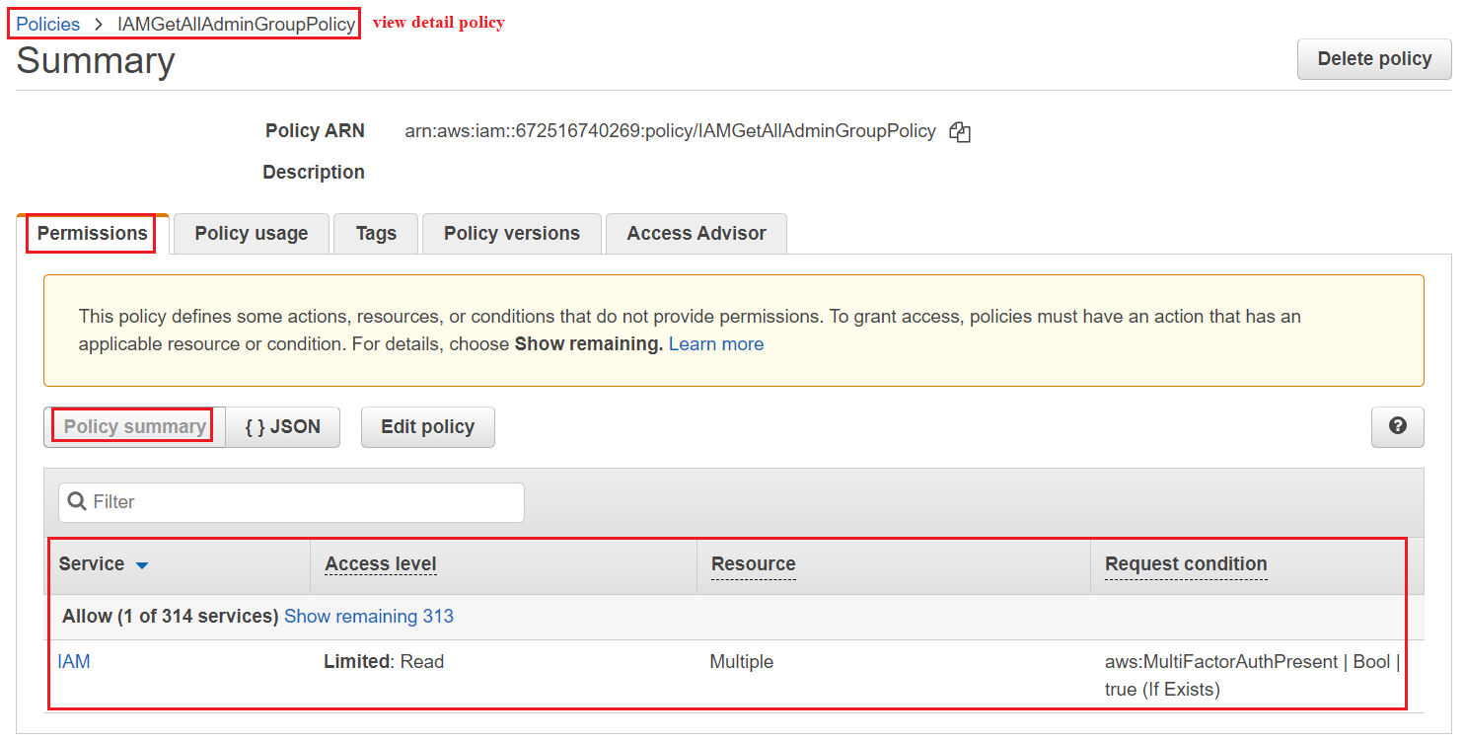
IAM Service
JSON
Policy summary

Slide 36
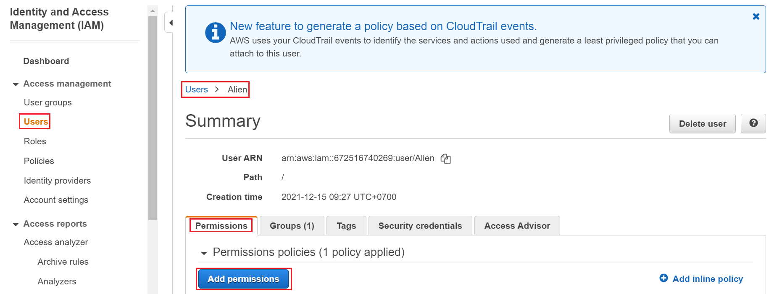
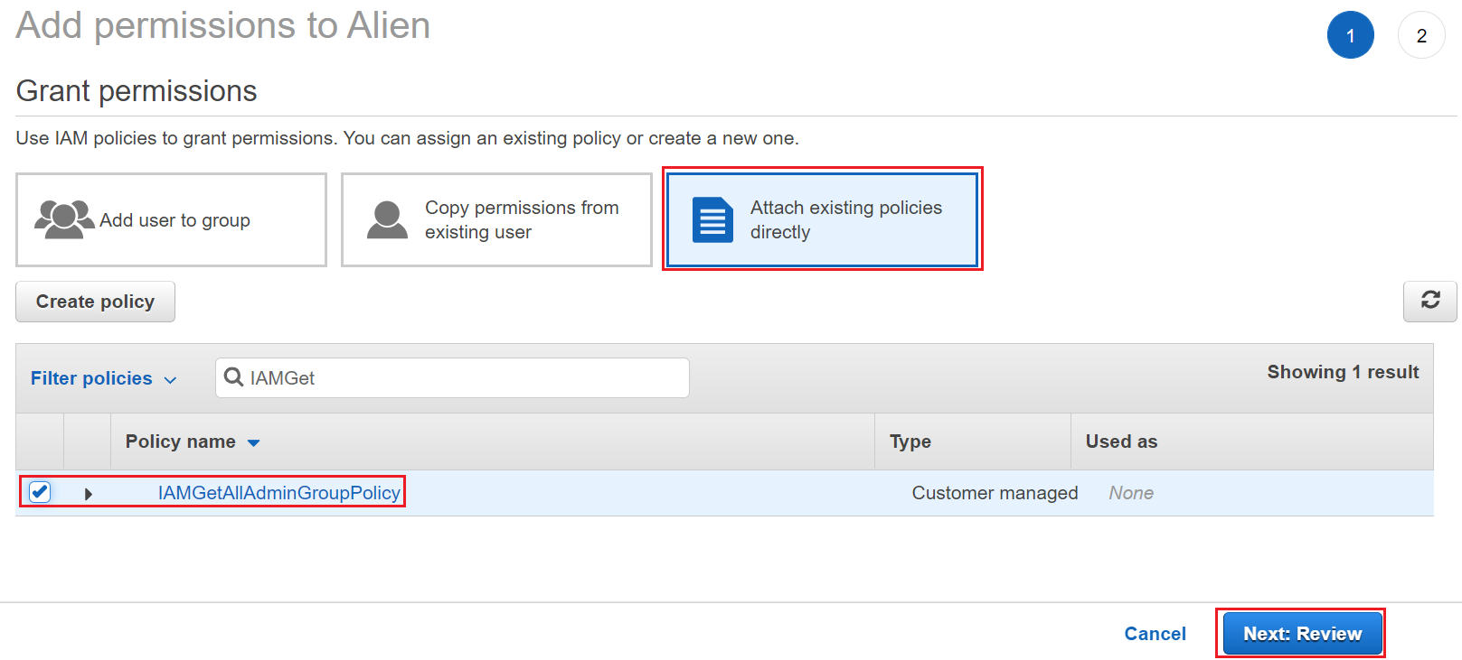
IAM Service
Attach policy to IAM User
When attaching policy to resource, identity, the policy will become permission

Slide 37

IAM Service
Test
Grant Permission
No Permission

Slide 38


IAM Service
Explain structure
Resource
Each resource has its own ARN (similar to ID)

Slide 39



IAM Service
Restrict based on tags
Force MFA
Restrict the client IP
Condition

Slide 40


IAM Service
Deny has priority higher than Allow
Blacklist and Whitelist strategies

Slide 41

IAM Service
Attach policy to Identities (IAM User, IAM Group, IAM Role)

Slide 42
IAM Service
More Example: https://docs.aws.amazon.com/IAM/latest/UserGuide/access_policies_examples.html

Slide 43
Assignment
Self-practice

Slide 44

IAM Service
2 Policy Types:
Customer managed
AWS managed

Slide 45
IAM Service
6 Policy Types:
Identity-based policy: Policy for identity (User, Group, Role)
Resource-based policy: Policy for resource (S3 bucket, EC2, ..., IAM User, IAM Group, IAM Role)
Session policy: Temporary session for Role, Federated User in API, CLI
Permissions boundary: use for Limiting permission of User, Role (Not support Group)
Organizations SCP: next lesson
ACL (Access Control List): next lesson

Slide 46


IAM Service
Identity-based policy & Resource-based policy
Identity-based policy
Resource-based policy

Slide 47


IAM Service
Policy Evaluation Logic
Example

Slide 48

IAM Service
Session policy

Slide 49


IAM Service
Permissions boundary
Usecases
Create Role forLambda function
Create Role for EC2 instances
Admins limit permission of groups, users

Slide 50

IAM Service
https://docs.aws.amazon.com/IAM/latest/UserGuide/reference_policies_evaluation-logic.html

Slide 51

IAM Service
Best practices
Apply the least privilege principle: don’t give more permissions than a user needs
Flow
https://docs.aws.amazon.com/IAM/latest/UserGuide/intro-structure.html

Slide 52
IAM Service
Tools
Access Advisor (user-level)
Access advisor shows the service permissions granted to a user and when those services were last accessed.
You can use this information to revise your policies.
Credentials Report (account-level)
A report that lists all your account's users and the status of their various credentials

Slide 53


IAM Service
Credentials Report
Access Advisor

Slide 54

IAM Service
Access Analyzer Tool
Monitor access to resources

Slide 55
Assignment
Self-practice

Slide 56
Summary
Identities: Users (Root User, IAM User, Federating existing user), IAM Group, IAM Role/Temporary security credentials, AWS Resource (S3, EC2, application, …)
Policies/Permission: Identity-based, Resource-based, Permission Boundary, Session
Feature: Password policy for IAM User, MFA, Access user via Console, CLI, SDK
Tools: Access Advisor/Credentials Report, Access Analyzer
Global service, Free
Common tasks: https://docs.aws.amazon.com/IAM/latest/UserGuide/introduction_quick-links-common-tasks.html

Slide 57
Q & A
Copyright © VTI Academy All Rights Reserved

